Slide 1

Group 8
DSF Phase 2 Project
9th March 2024

Slide 2
Group Members
steve.abonyo@student.moringaschool.com
brian.kariithi@student.moringaschool.com
rosaline.mungai@student.moringaschool.com
ruth.nyakio@student.moringaschool.com
lynette.mwiti@student.moringaschool.com
ivan.wawire@student.moringaschool.com

Slide 3

1
Overview
Multiple linear regression of Northwestern County real estate sales data reveal opportunities for home owners to renovate houses and increase their property values:
Upgrade the sizes of the living and increase number of bedrooms and bathrooms
Entire house renovations are encouraged than partial renovations.
Improve overall condition of the house by regular maintenance.

Slide 4

Business Problem
2
In the attempt to get to know the impact of the renovations in house values, Finsco Group have provided Hepta group with the sales data to come up with an analysis to support this business proposal.
Hepta Group will conduct a multiple linear regression model to analyse the house sales in the northwestern county .
The goal is to get insights to provide advice to homeowners, real estate investors and clients who do house-flipping.

Slide 5

Implications of the Analysis
3
With the insights provided, Finsco Limited and its clients can strategically invest in real estate by choosing renovations that significantly increase home values.
Homeowners working with Finsco's consultancy learn which renovations offer the best returns, helping them wisely enhance their properties.
House flippers working with FINSCO consultancy can tailor their strategies to target high-ROI renovations.
The consultancy success not only benefits Finsco and its clients but also stimulates economic growth through increased renovation and property transaction activities.

Slide 6
Data & Methodology
4
Data
Limitations
Data provided was King County House Sales data collected from 2014 and 2015.
The target variable from this dataset is the property prices.
Main factors affecting the price are sqft_living, bathrooms, bedrooms, condition, sqft_lot, floors and year_blt
Dealing with missing values in some of the predictor variables like waterfront and view.
Non-numerical variables. which have to be encoded before in building our model

Slide 7

Methodology
5
Data cleaning: Handling duplicates, missing, null values and encoding categorical variables
Data visualization: Heatmaps, Histograms, Tableau, scatter plots and linear regression models
Simple Regression: Predicting price variable using one independent variable e.g. sqft_living, bathrooms ,bedrooms (Baseline Model)
Multiple Regression: Used to predict our price using two or more independent variables e.g. sqft_living, bathrooms, bedrooms

Slide 8
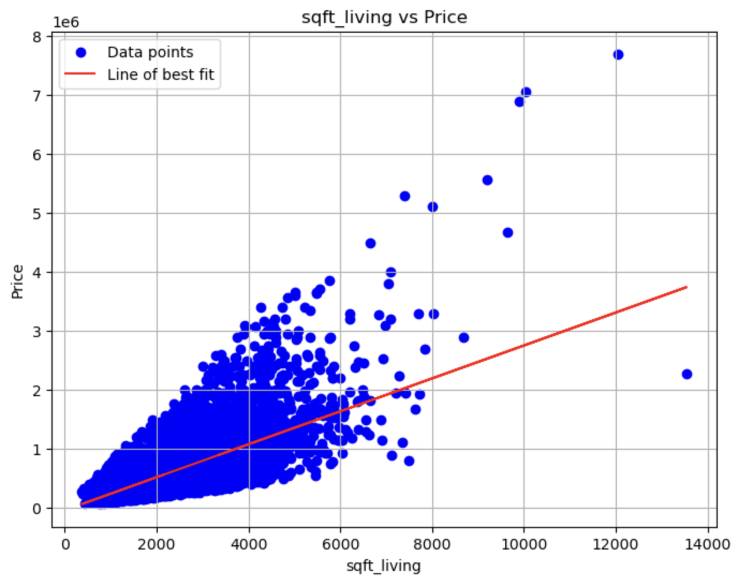
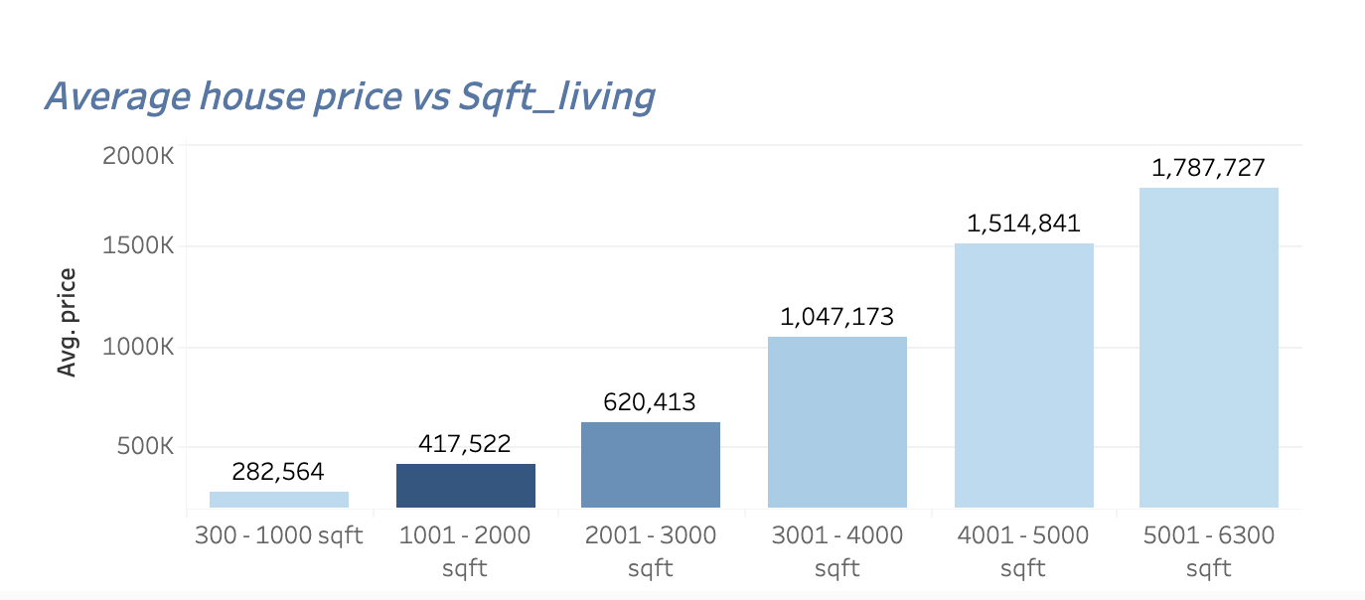
Results
6
Increase in living area size increases property price
For 1 additional square feet, the home value increases by USD 279

Slide 9
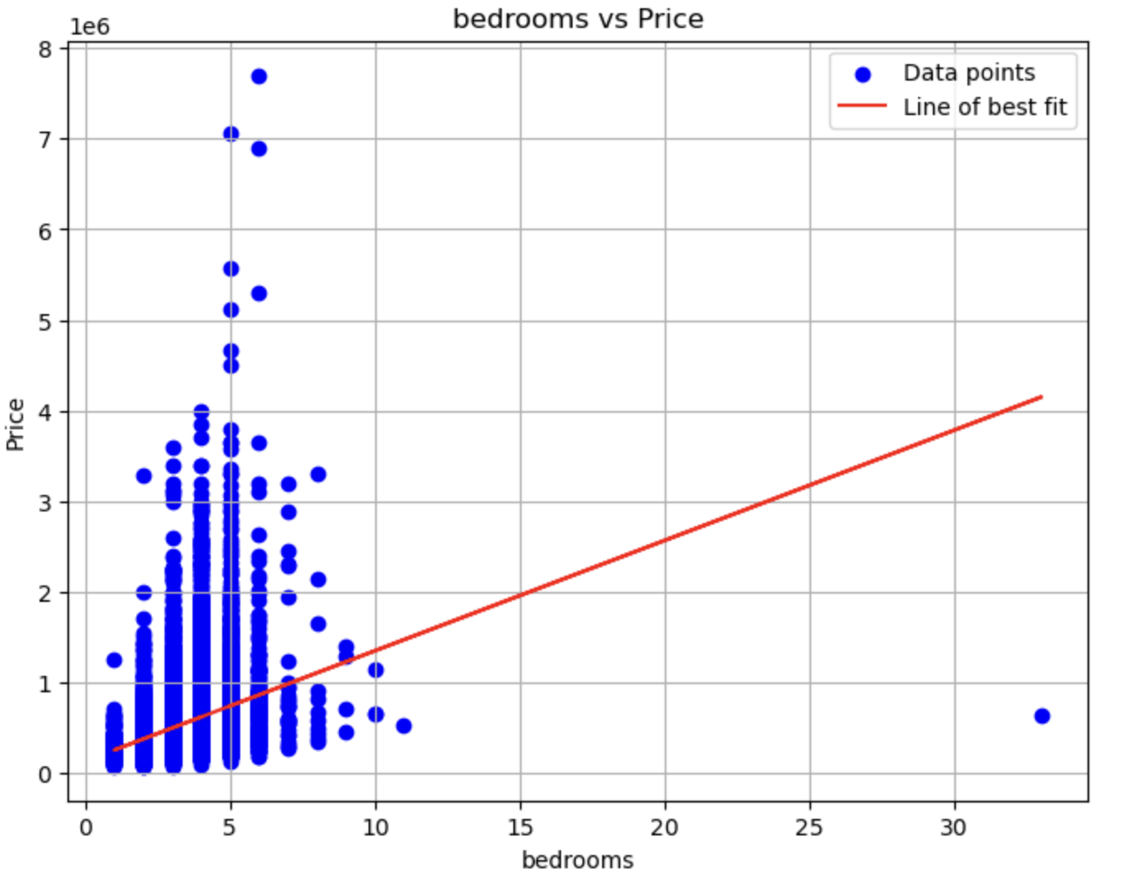
Results
7
Properties with more bedrooms, have a higher price.
Clients prefer 3 to 6 bedrooms
1 additional bathroom, can increase the property price by USD 121,794

Slide 10
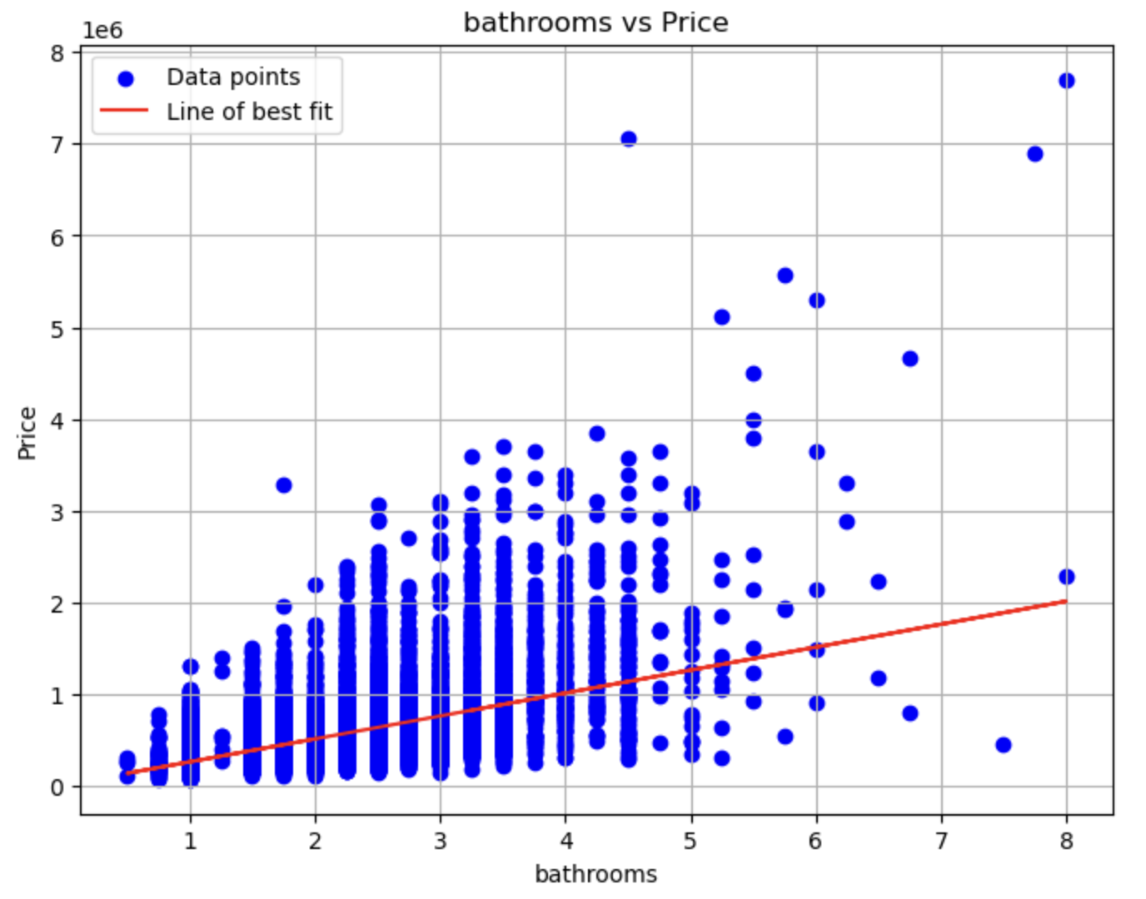
Results
8
More bathrooms increase house prices.
1 additional bathroom, can increase the price by USD 250,000

Slide 11
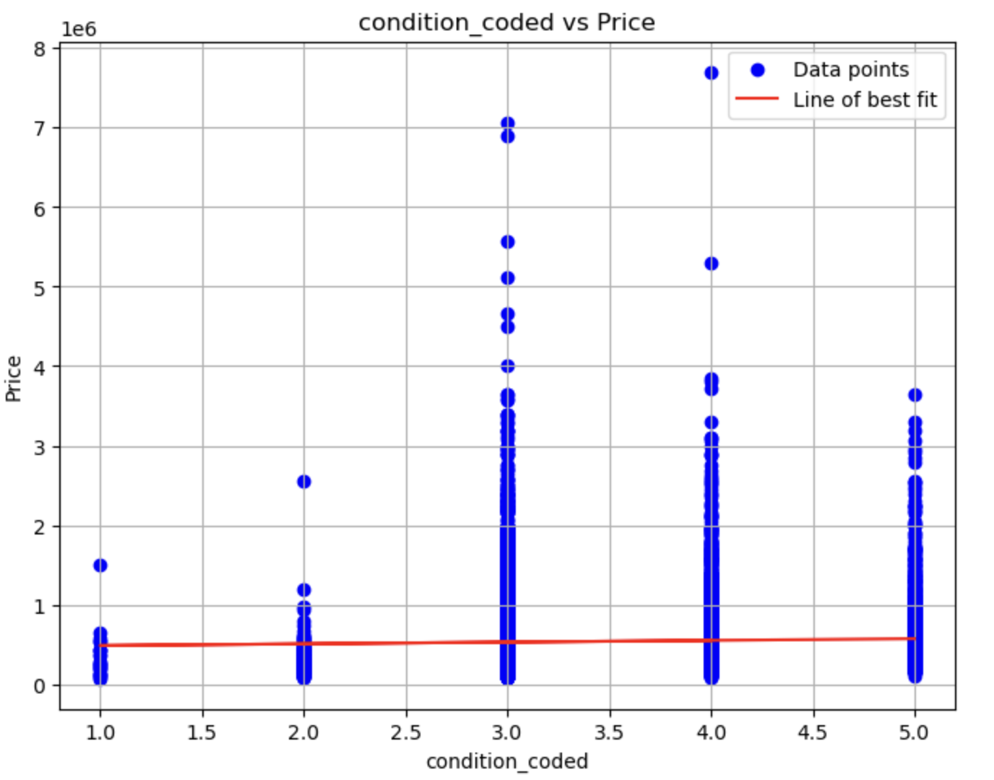
Results
9
A well maintained house will have more value
Improving house maintenance can increase the property value by USD 21, 460

Slide 12
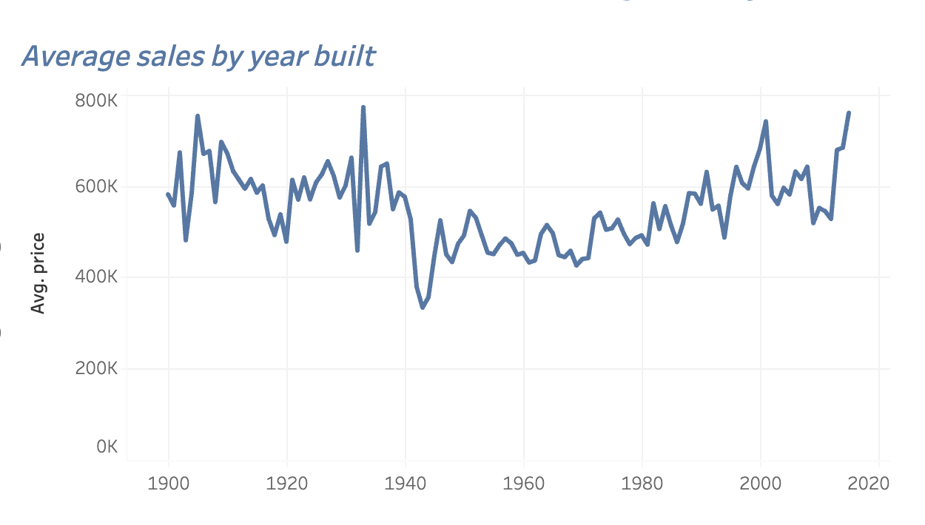
Results
7
Houses built around 1930 and in the 21’st century have a high sale value

Slide 13
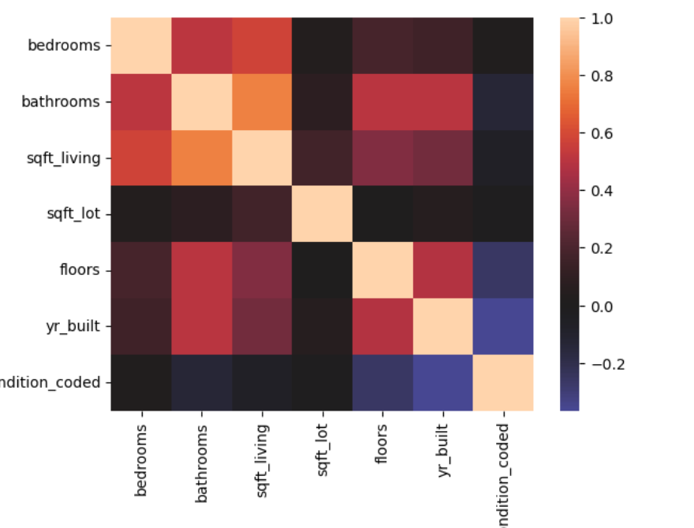
Data Visualization
Living room size, bathrooms and bedrooms have the highest effect on the value of the homes
The year the house was built and overall condition of the house have the least effect on the price

Slide 14
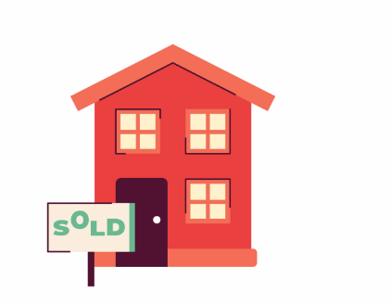

Conclusion
9
From the analysis and model summary,it can be concluded that the proposed multiple linear regression model can effectively analyze and predict the housing price.
Overall house improvements will have a better impact on the value of the property than just renovating part of the house

Slide 15
Recommendations
10
Finsco Limited advise to its client:
Increase the size of the living room (sqfit_living). Bigger living spaces attract high prices.
Upgrading bedrooms. Investing in bedroom renovations, will increase the value of the property.
Good house maintenance will improve the value of the homes. Home owners should ensure their homes rated average and above to improve the home value
Bathroom is a minimum requirement and significant item in determining the home value. Assumption is that “advanced” / “more’ bathrooms attract higher prices

Slide 16
Next Steps
11
Feedback gathering: Hepta team will gather feedback from the Finsco team for additional requirements and feedback.
Market Research: We will conduct market research to identify trends in the real estate market such as renovations and, property features demands.
Data Enrichment: Gather additional data on other features that affect property values. This may include users' preferences and more sales and renovations data.
Model improvement: Our Data scientists will try other regression algorithms for comparisons and model improvements

Slide 17
Thank You
Group 8 Phase 2 Final Project

